Slide 1



Master Benefit Grid Overview

Slide 2
Contents
MBG Overview
Acronyms
Functionality Overview
Detailed Flow
Scenarios
Sample MBG Extracts and BO Reports
Q&A

Slide 3
MBG Overview
MBG stands for Master Benefit Grid.
It extracts data from MAPS DB for both Public and Secure Plans.
The MBG is used throughout the company as a source of truth for plan, benefit & geography data.
MAPS uses several load templates to populate the MBG
PBP Software
UWG
OSG
HPMS
Footnotes Template
MDCS Template

Slide 4
Continued..
MBG (Master Benefit Grid) and other benefit extracts
MBG will Contain Benefit Information for the Individual and Employer plans comes from PBP only.
Plan level Info
Plan county info
Benefit Level Info
Medical Benefit Details (both in and Out of Networks)
Optional Benefit Details (both in and Out of Networks)
Part D Benefit Details

Slide 5
Continued..
Data from MAPS DB is extracted in Base extract & BO report.
For Base MBG extract Console app from app server has to be executed.
For BO report user has to login to BO portal.
BO report extracts data from Reporting DB.
Prior to running BO report, Job_MBG.dtsx and reporting replication jobs has to be executed.
MBG BO Reports are of two types, Public MBG & Secure MBG.
MBG BO Compare Reports are there which compares data for current year and prior year.
If there are difference in values then cells will be highlighted in orange to show the value changes.

Slide 6
Acronyms
MBG - Master Benefit Grid
INN - In Network
OON - Out of Network
BO - Business Objects
PBP - Plan Benefit Package
UWG - Under Writing Grid (UWG)
OSG - Optional Supplemental
HPMS - Health Plan Management System
MDCS - Medicare Defined cost shares

Slide 7
Functionality Overview
How the files are generated?
Executable Server: APSET0368, DBSET0070
E:\SSIS_Root\MPS\Loads\mbgConsole\v6_2014
Data base: DBSW8218, DBSWT0023
Latest mapping documents as of today are available on ADR2 in the following path.
http://adr2.uhc.com/apps/MAPS/20140621_C10782462/defa ult.aspx (Q2 2014 June Release latest)

Slide 8
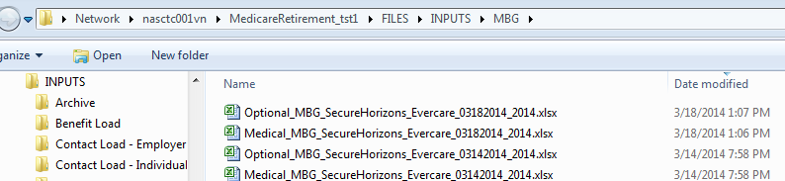
Detailed Flow contd..
The extract retrieves data only for the current plan year i.e. if we are running 2014 console app only 2014 plans will be retrieved in the extract
MBG console is executed two extracts are generated. Medical MBG and Optional MBG. Medical MBG extracts data for Medical benefit detail types. Whereas Optional MBG extracts data for Deluxe, Dental 260, Dental 466, Dental Platinum, High Optional Dental, Optional Dental and Fitness benefit types.
Extract Location after running console app in app server:

Slide 9
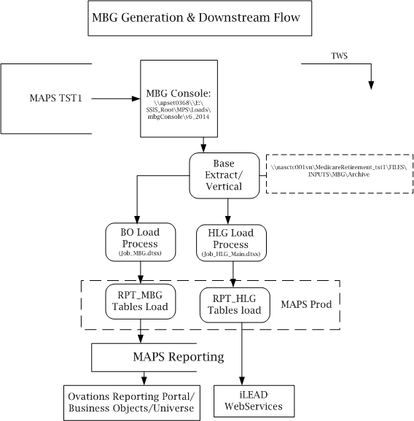
Down Stream Flow..

Slide 10
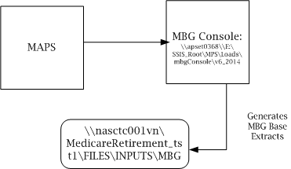
Scenarios
Step1: Process the exe file in the above path. After processing the MBG console application, two files are generated as output.
Medical MBG
Optional MBG

Slide 11
Scenarios contd…
Step 2: The output files will be placed in the below path and these files will become the input files for the other jobs.
\\nasctc001vn\MedicareRetirement_tst1\FILES\INPUTS\MBG
Step 3: All errors are logged in text file in the below path.
E:\SSIS_Root\MPS\Loads\mbgConsole\v6_2014\Logs
Note:
Data for each business segment and plan type combination is extracted in separate work sheet in the extract.

Slide 12
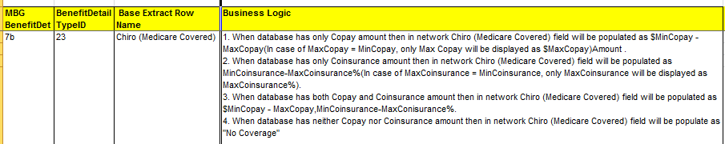
Scenarios contd…
Step 1: Medical and Optional Benefits data for all the Individual Plans (Secure and Public) are fetched from MAPS database and the generated files are placed in shared input path.
Step 2: The data is displayed in MBG Base Extract files as it is defined in the Mapping document.

Slide 13
Scenarios contd…
Scenarios for benefits which have only cost share min & max values:
Identify a 2014 plan in MAPS DB for the below scenarios and verify extract for values in MPS DB.
Scenario 1:
1. MedicalBenefitDetail.CopayMinAmount > 0.00
2. MedicalBenefitDetail.CopayMaxAmount > 0.00
3. MedicalBenefitDetail.CoInsuranceMinPercent is 0.0
4. MedicalBenefitDetail.CoInsuranceMaxPercent is 0.0
1 & 2 above are the same Copay Amount

Slide 14
Scenarios contd…
Scenario 2:
1. MedicalBenefitDetail.CopayMinAmount is 0.00
2. MedicalBenefitDetail.CopayMaxAmount is 0.00
3. MedicalBenefitDetail.CoInsuranceMinPercent > 0.00
4. MedicalBenefitDetail.CoInsuranceMaxPercent > 0.00
3 & 4 above are the same Coins %
Scenario: 3
1. MedicalBenefitDetail.CopayMinAmount is 0.00
2. MedicalBenefitDetail.CopayMaxAmount is 0.00
3. MedicalBenefitDetail.CoInsuranceMinPercent > 0.0
4. MedicalBenefitDetail.CoInsuranceMaxPercent > 0.0
1 & 2 above are not the same Coins %

Slide 15
Scenarios contd…
Scenario 4:
1. MedicalBenefitDetail.CopayMinAmount > 0.00
2. MedicalBenefitDetail.CopayMaxAmount > 0.00
3. MedicalBenefitDetail.CoInsuranceMinPercent > 0.0
4. MedicalBenefitDetail.CoInsuranceMaxPercent > 0.0
1 & 2 above are not the same Copay Amount
3 & 4 above are not the same Coins %
Scenario 5:
1. MedicalBenefitDetail.CopayMinAmount > 0.00
2. MedicalBenefitDetail.CopayMaxAmount > 0.00
3. MedicalBenefitDetail.CoInsuranceMinPercent > 0.0
4. MedicalBenefitDetail.CoInsuranceMaxPercent > 0.0
1 & 2 above are the same Copay Amount
3 & 4 above are the same Coins %

Slide 16
Scenarios contd…
Scenario 6:
1. MedicalBenefitDetail.CopayMinAmount is null
2. MedicalBenefitDetail.CopayMaxAmount is null
3. MedicalBenefitDetail.CoInsuranceMinPercentis null
4. MedicalBenefitDetail.CoInsuranceMaxPercent is null
Scenario 7:
1. MedicalBenefitDetail.CopayMinAmount is 0.00
2. MedicalBenefitDetail.CopayMaxAmount is 0.00
3. MedicalBenefitDetail.CoInsuranceMinPercentis 0.00
4. MedicalBenefitDetail.CoInsuranceMaxPercent is 0.00

Slide 17
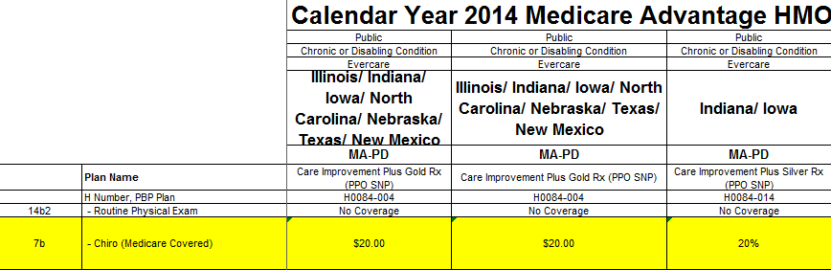
Scenarios contd…
Scenario 8 :
1. MedicalBenefitDetail.CopayMinAmount > 0.00
2. MedicalBenefitDetail.CopayMaxAmount > 0.00
3. MedicalBenefitDetail.CoInsuranceMinPercent is 0.0
4. MedicalBenefitDetail.CoInsuranceMaxPercent is 0.0
1 & 2 above are not the same Copay Amount
Sample MBG Extract:

Slide 18
MBG Extracts and BO reports…
Sample MBG Extracts:
BO Reports:

Slide 19
MBG BO Links
MBG BO Repot Links:
TST1/TST2: http://orbit-businessobjects-test/BOE/BI
UAT: http://orbit-businessobjects-stage/BOE/BI

Slide 20
Q&A

Slide 21
Thank you!!

